Slide 1

DISJOINT SET
Prepared by
Lec Shekh. Md. Saifur Rahman
PREPARED BY
SWAPNIL BISWAS

Slide 2
DISJOINT SET OPERATIONS
makeSet()
O(1)
(1,3)
Union(a,b)
O(logn)
findSet(a)
O(logn)
(6,7)
(6,1)
1
2
3
4
5
6
7

Slide 3
KRUSKAL’s ALGORITHM (SIMULATION)
1
2
19
2
9
5
14
17
8
25
5
8
9
21
13
1
13
14
Sort the edges in ascending order
17
Create a set T for the MST with no edges
19
21
25

Slide 4
KRUSKAL’s ALGORITHM (SIMULATION)
1
2
19
2
9
5
14
17
8
25
5
8
9
X
21
13
1
1
13
14
DONE!
Sort the edges in ascending order
17
Create a set T for the MST with no edges
19
Connect n-1 edges with no cycle
21
25

Slide 5
MakeSet
Let there are n elements denoted from 1 to n
Consider n = 8
All the 8 elements belong to 8 disjoint sets
Each set has an unique representative
makeSet(i) sets the parent of i as i
for(i=1; i<=n; i++) parent[i] = i;
1
2
3
4
5
6
7
8
parent
1
2
3
4
5
6
7
8
1
2
3
4
5
6
7
8

Slide 6
Same Set Condition
a and b belongs to same set if representative(a) = representative(b)

Slide 7
Representative Identification
If for an element r we find par[r] = r then r is definitely a representative of a disjoint set

Slide 8
Union
union(a,b) brings b into the set of a if a and b belong different sets otherwise union is not possible
union(3,5)
1
2
3
4
5
6
7
8
parent
1
2
3
4
5
6
7
8
1
2
3
4
5
6
7
8

Slide 9
Union
union(a,b) brings b into the set of a if a and b belong different sets otherwise union is not possible
union(3,5)
1
2
3
4
5
6
7
8
parent
1
2
3
4
3
6
7
8
1
2
3
4
5
6
7
8

Slide 10
Union
union(a,b) brings b into the set of a if a and b belong different sets otherwise union is not possible
union(3,5)
union(3,2)
1
2
3
4
6
7
8
5
parent
1
2
3
4
3
6
7
8
1
2
3
4
5
6
7
8

Slide 11
Union
union(a,b) brings b into the set of a if a and b belong different sets otherwise union is not possible
union(3,5)
union(3,2)
union(6,4)
1
2
3
4
6
7
8
5
parent
1
3
3
4
3
6
7
8
1
2
3
4
5
6
7
8

Slide 12
Union
union(a,b) brings b into the set of a if a and b belong different sets otherwise union is not possible
union(3,5)
union(3,2)
union(6,4)
1
2
3
4
6
7
8
5
parent
1
3
3
6
3
6
7
8
1
2
3
4
5
6
7
8

Slide 13
Union
union(a,b) brings b into the set of a if a and b belong different sets otherwise union is not possible
union(3,5)
Wrong!!
union(3,2)
union(6,4)
1
2
3
4
6
7
8
union(2,4)
5
representative(2) = 3
representative(4) = 6
parent
1
3
3
6
3
6
7
8
1
2
3
4
5
6
7
8

Slide 14
Union
union(a,b) brings b into the set of a if a and b belong different sets otherwise union is not possible
union(3,5)
union(3,2)
Correct!!
union(6,4)
1
2
3
4
6
7
8
union(2,4)
5
representative(2) = 3
representative(4) = 6
parent
1
3
3
6
3
6
7
8
1
2
3
4
5
6
7
8

Slide 15
Union
union(a,b) brings b into the set of a if a and b belong different sets otherwise union is not possible
union(3,5)
union(3,2)
union(6,4)
1
2
3
4
6
7
8
union(2,4)
5
representative(2) = 3
representative(4) = 6
parent
1
3
3
6
3
3
7
8
1
2
3
4
5
6
7
8

Slide 16
Union
union(a,b) brings b into the set of a if a and b belong different sets otherwise union is not possible
union(3,5)
union(3,2)
union(6,4)
1
2
3
4
6
7
8
union(2,4)
5
Steps
Ra = findRepresentative(a)
Rb = findRepresentative(b)
parent
1
3
3
6
3
3
7
8
parent[Rb] = Ra
1
2
3
4
5
6
7
8

Slide 17
Union
union(a,b) brings b into the set of a if a and b belong different sets otherwise union is not possible
union(3,5)
union(3,2)
union(6,4)
1
2
3
4
6
7
8
union(2,4)
union(7,4)
5
parent
1
3
3
6
3
3
7
8
1
2
3
4
5
6
7
8

Slide 18
Union
union(a,b) brings b into the set of a if a and b belong different sets otherwise union is not possible
union(3,5)
union(3,2)
union(6,4)
1
2
3
4
6
7
8
union(2,4)
union(7,4)
5
parent
1
3
7
6
3
3
7
8
1
2
3
4
5
6
7
8

Slide 19
Union
union(a,b) brings b into the set of a if a and b belong different sets otherwise union is not possible
union(3,5)
union(3,2)
union(6,4)
1
2
3
4
6
7
8
union(2,4)
union(7,4)
union(3,6)
X Not possible
5
parent
1
3
7
6
3
3
7
8
1
2
3
4
5
6
7
8

Slide 20
Union
union(a,b) brings b into the set of a if a and b belong different sets otherwise union is not possible
union(3,5)
union(3,2)
union(6,4)
1
2
3
4
6
7
8
union(2,4)
union(7,4)
union(3,6)
5
union(1,8)
parent
1
3
7
6
3
3
7
8
1
2
3
4
5
6
7
8

Slide 21
Union
union(a,b) brings b into the set of a if a and b belong different sets otherwise union is not possible
union(3,5)
REDRAWING
union(3,2)
union(6,4)
1
2
3
4
6
7
8
union(2,4)
union(7,4)
union(3,6)
5
union(1,8)
parent
1
3
7
6
3
3
7
1
1
2
3
4
5
6
7
8

Slide 22
Union
union(a,b) brings b into the set of a if a and b belong different sets otherwise union is not possible
union(3,5)
union(3,2)
7
union(6,4)
1
union(2,4)
3
union(7,4)
8
union(3,6)
2
5
6
union(1,8)
4
parent
1
3
7
6
3
3
7
1
1
2
3
4
5
6
7
8

Slide 23
FindRepresentative(x)
findRepresentative(4)
Recursion
x
parent[x]
Return
7
7
1
fR(4)
4
6
7
fR(6)
6
3
7
3
7
8
fR(3)
3
7
7
7
fR(7)
7
7
7
2
5
6
int fR(int x){
if(x==parent[x]) return x;
int r = fR(parent[x]);
return r;
}
4
7
parent
1
3
7
6
3
3
7
1
1
2
3
4
5
6
7
8

Slide 24
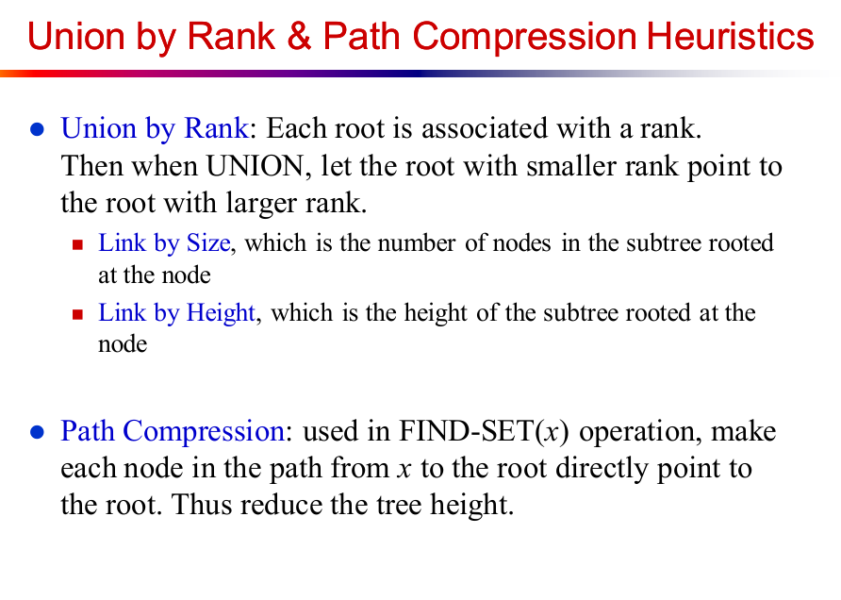

Slide 25
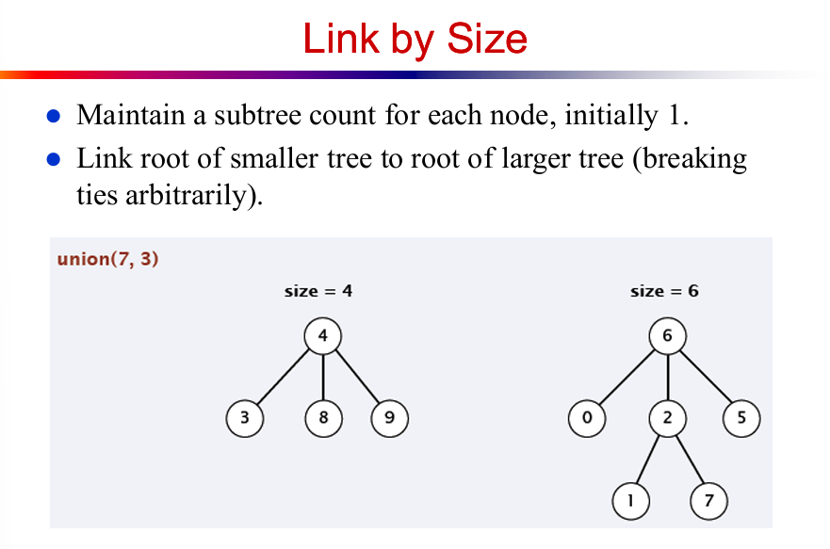

Slide 26
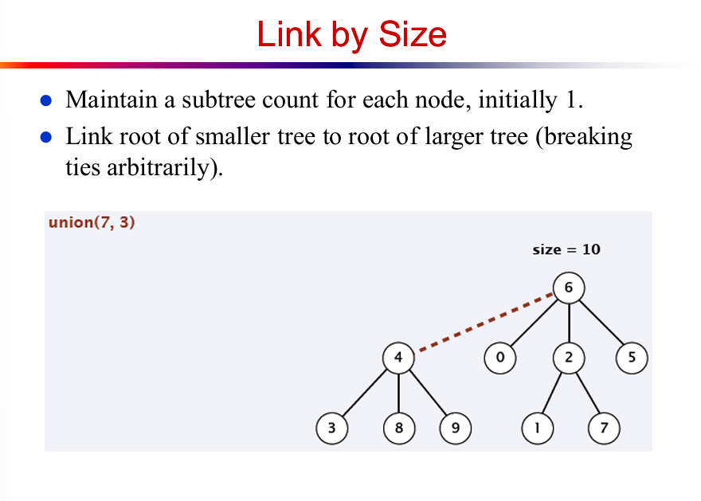

Slide 27
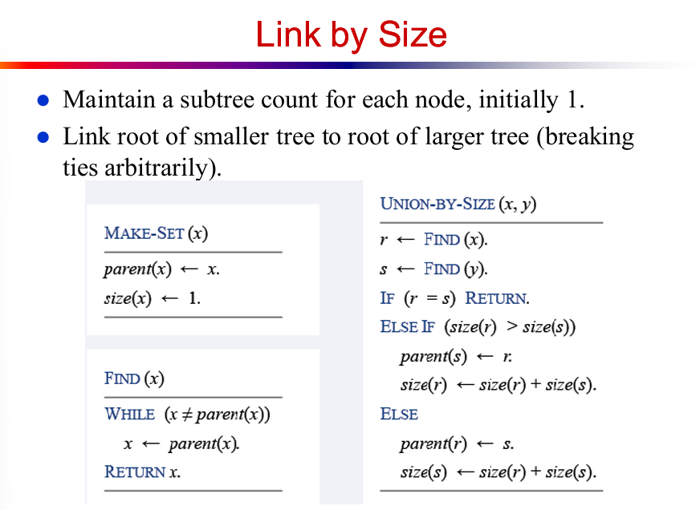

Slide 28
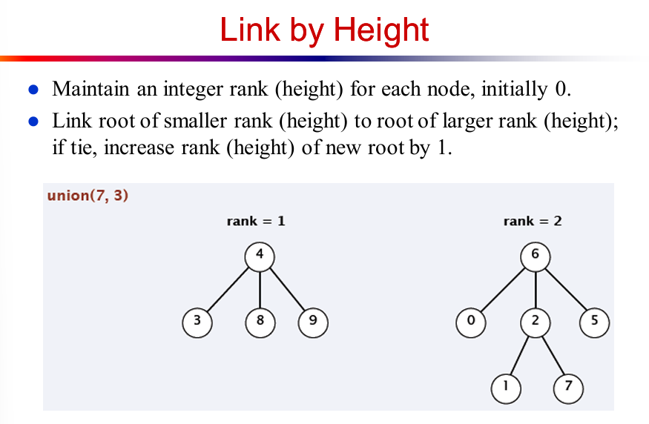

Slide 29
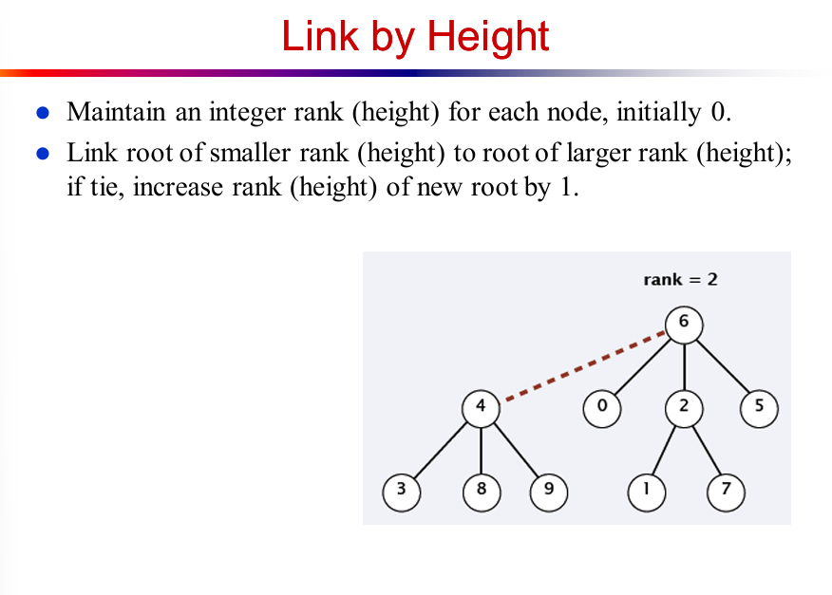

Slide 30
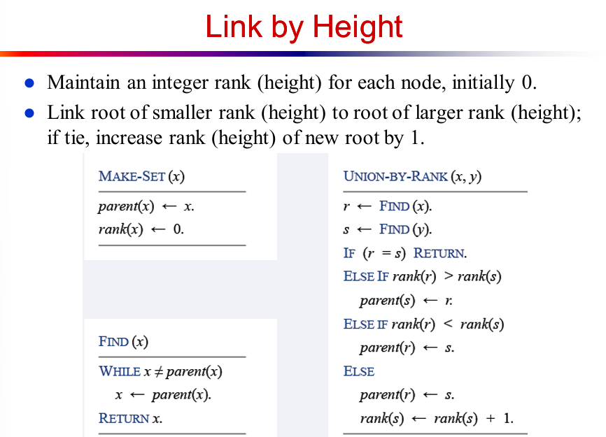

Slide 31
FindRepresentative with Path Compression
findRepresentative(4)
Recursion
x
parent[x]
Return
7
7
1
fR(4)
4
6
fR(6)
6
3
7
7
3
8
fR(3)
3
7
7
fR(7)
7
7
7
2
5
7
6
4
parent
1
3
7
6
3
3
7
1
1
2
3
4
5
6
7
8

Slide 32
FindRepresentative with Path Compression
findRepresentative(4)
Recursion
x
parent[x]
Return
7
7
1
fR(4)
4
6
7
7
fR(6)
6
3
7
3
8
fR(3)
3
7
7
7
6
fR(7)
7
7
7
2
5
4
parent
1
3
7
6
3
7
7
1
1
2
3
4
5
6
7
8

Slide 33
FindRepresentative with Path Compression
findRepresentative(4)
Recursion
x
parent[x]
Return
7
7
1
fR(4)
4
6
7
fR(6)
6
7
7
7
3
8
fR(3)
3
7
7
7
6
fR(7)
7
7
7
2
5
7
4
parent
1
3
7
6
3
7
7
1
1
2
3
4
5
6
7
8

Slide 34
FindRepresentative with Path Compression
findRepresentative(4)
Recursion
x
parent[x]
Return
7
7
fR(4)
6
7
1
4
7
7
7
7
7
fR(6)
6
3
4
8
fR(3)
3
7
7
7
6
fR(7)
7
7
7
2
5
int fR(int x){
if(x==parent[x]) return x;
int r = fR(parent[x]);
par[x] = r;
return r;
}
parent
1
3
7
7
3
7
7
1
1
2
3
4
5
6
7
8

Slide 35
FindRepresentative with Path Compression
findRepresentative(4)
Recursion
x
parent[x]
Return
7
7
fR(4)
6
7
1
4
7
7
7
7
7
fR(6)
6
3
4
8
fR(3)
3
7
7
7
6
fR(7)
7
7
7
2
5
Now what is the complexity to find the representative of 4?
Ans: O(1)
parent
1
3
7
7
3
7
7
1
1
2
3
4
5
6
7
8

Slide 36
Union with Path Compression
Union(2,8)
int r1 = fR(2);
1
11
5
10
9
3
4
12
8
2
13
7
6

Slide 37
Union with Path Compression
Union(2,8)
int r1 = fR(2);
[r1 = 1]
11
1
10
9
2
5
3
12
8
6
4
7
13

Slide 38
Union with Path Compression
Union(2,8)
int r1 = fR(2);
[r1 = 1]
int r2 = fR(8);
11
1
10
9
2
5
3
12
8
6
4
7
13

Slide 39
Union with Path Compression
Union(2,8)
int r1 = fR(2);
[r1 = 1]
int r2 = fR(8);
[r2 = 11]
11
parent[r2] = r1;
1
8
10
9
2
5
13
3
6
4
12
7

Slide 40
Union with Path Compression
Union(2,8)
int r1 = fR(2);
[r1 = 1]
int r2 = fR(8);
[r2 = 11]
11
parent[r2] = r1;
[parent[11] = 1]
1
8
10
9
2
5
13
3
6
4
12
7

Slide 41
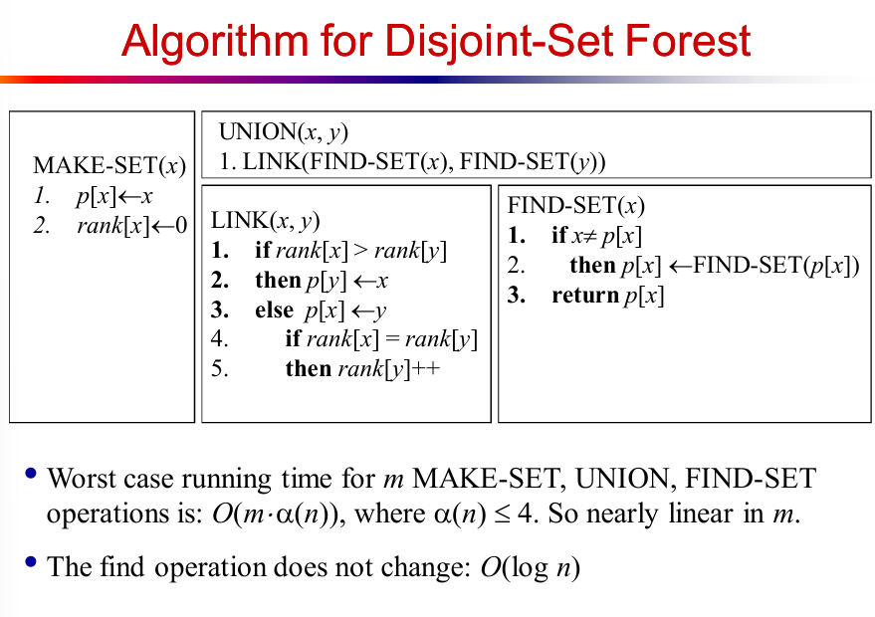

Slide 42
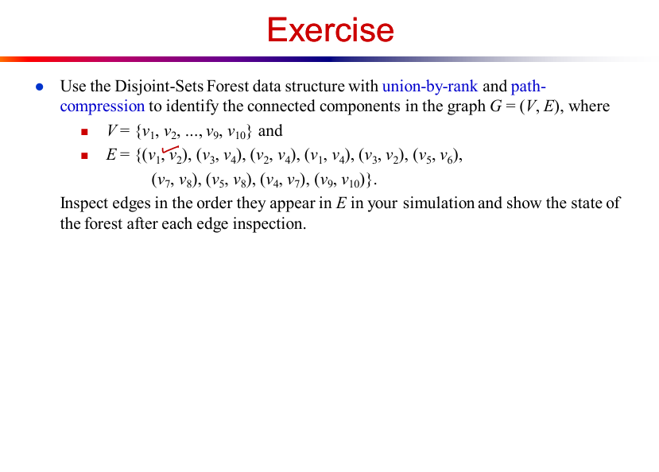

Slide 43
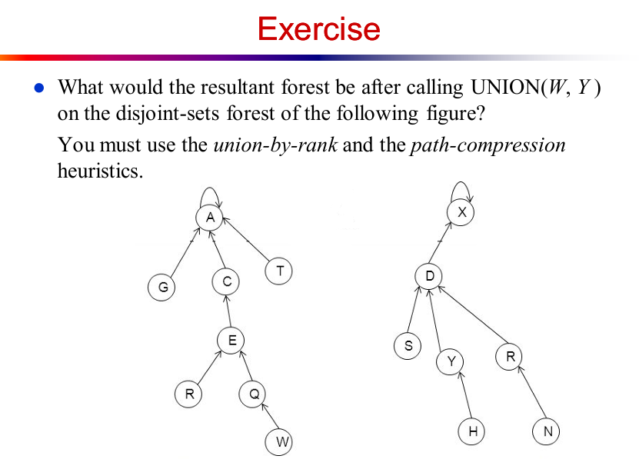

Slide 44
